Slide 1
Machine Learning Overview

Slide 2
Key questions
What can you do with machine learning? (and what can’t you do?)
Where does ML fit in a data-to-decision workflow?

Slide 3
A short history of the world…
The earth cooled
(… time passes…)
Humans arrived* and made decisions
Language and Math/Logic is created and people write rules for making decisions
Computers invented: able to make faster decisions
Humans write fixed programs to make decisions using (probabilistic) distilled judgements about relationships in the data [Expert systems]
Humans decided that the computer would be better at learning statistical relationships between attributes of the data [Machine Learning]
*Insert scientific and/or religious word of your choosing here

Slide 4
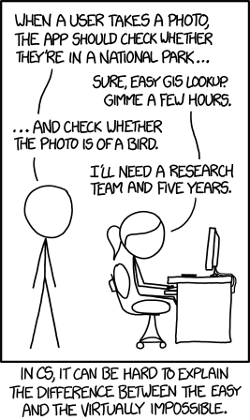
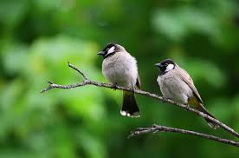

What can you do with Machine Learning?
Infer how data elements are related
Does ice cream consumption depend on outdoor temperature?
Make predictions about a target variable within a dataset
How much ice cream will be consumed this summer in Ohio?
Determine the category something belongs to
Bird vs non-bird
https://www.pexels.com/search/birds/
https://en.wikipedia.org/wiki/Strelitzia
xkcd #1425 (View original here)

Slide 5
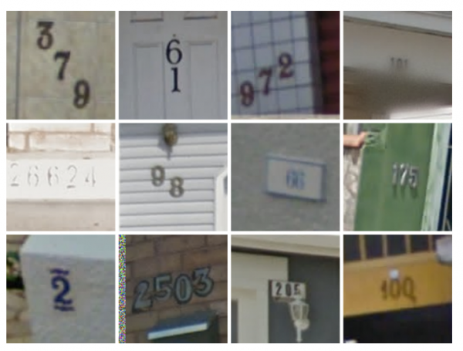
What can you do with Machine Learning(2) ?
Optical Character/Number recognition
Translate Text between languages
Audio<->Text
Find Components of an image
Describe the contents of an image
Pick the best <restaurant; movie; product; …> for me
https://www.technologyreview.com/s/523326/how-google-cracked-house-number-identification-in-street-view/

Slide 6
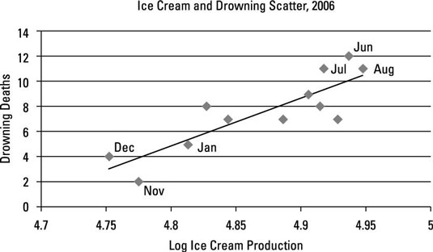
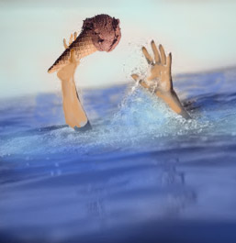
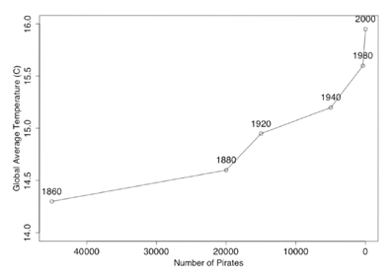
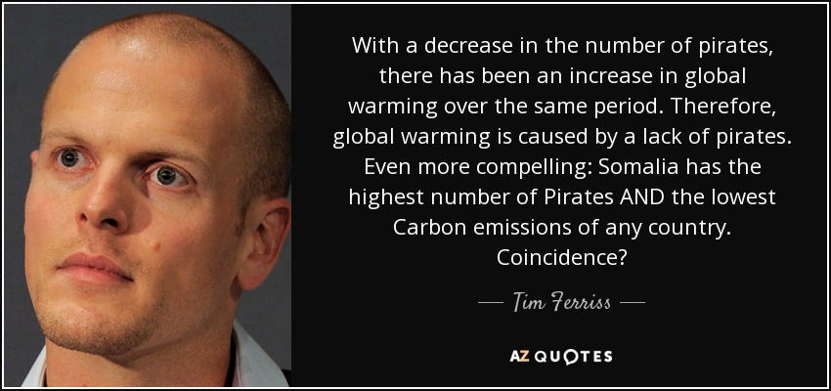
What can’t you do with ML?
Determine causality
Production of ice cream is correlated with drowning. Which way is the causality?
Determine whether data is Evidence or Coincidence
http://www.dummies.com/education/economics/ econometrics/the-role-of-casuality-in-econometrics/
http://sourcesandmethods.blogspot.com/2011/03/passport-ownership-cures-diabetes.html

Slide 7
What can’t you do with just ML (2)
Find the fastest route to an address on a map (use a cost-based pathfinding algorithm)
Learn to Play Chess, Checkers, Go (efficiently) (use a heuristic deep search algorithm)
Determine geocoordinates from only a photo (this only works for some common locations…)
Drive a vehicle autonomously (this requires much more than ML)

